Slide 1
Communication and Presentation Skills
Spring 2022

Slide 2
Course Content Spring 2022
Weeks | Contents/Topics | CLO | Assessment
1 | Communication theory, define communication, types (inter, intra, public, mass) process of communication | 1 | Q1, M1, F
2 | Oral Communication, challenges of communication, barriers to oral communication and strategies to overcome barriers. | 1, 2 | A1, M1, F
3 | Barriers practice, Presentation Skills: Content generation, Script generation | 1, 2 | Q2, M1, F
4 | Story boarding, preparing audio visual aids and delivering presentation | 1, 2 | Q2, M1, F
5 | Principles of effective communication: Completeness, Concreteness, | 3 | P1, F
6 | Mid 1
7 | Consideration, Courtesy, Conciseness | 2 | Q3, M1, F
8 | Correctness, Clarity, Active Listening | 3
9 | Project 1: Presentation | 1 | A2, M2, F
10 | Active Listening, Demonstrative Speeches | 1 | A2, M2, F
11 | Mid 2
12 | Business Meetings | 4 | A2, F
13 | Writing Minutes | 3 | P2, F
14 | Job interview skills | 4 | A3, F
15 | Project 2: Demonstrative speech (assignment submission)
16 | Project 3: Job Interview | 3

Slide 3
Marks Distribution
Mid-I: 15
Mid-II: 15
Assignments/Quizzes: 10
Project: 10
Final: 50

Slide 4
Google Classroom Code
CPS Sec G Spring 2022
Class code: xbn2fee
https://classroom.google.com/c/NDYwOTkzMDYyOTI3?cjc=folkvpn

Slide 5

Contact Information

Slide 6
WHAT IS COMMUNICATION?
Communication is the process of transferring information and meaning between senders and receivers, using one or more written, oral, visual, or electronic channels.
Communication is a process by which meaning is assigned and conveyed in an attempt to create shared understanding. It is an interactive process.

Slide 7
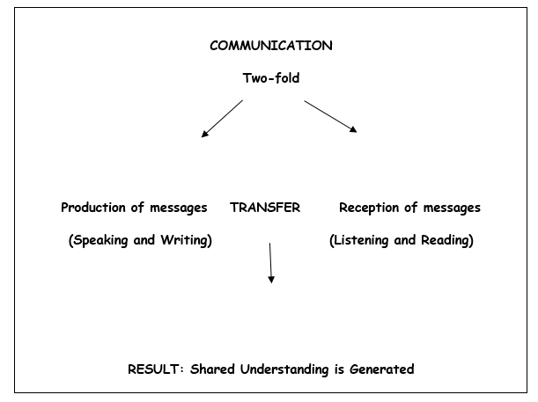

Slide 8
HISTORY OF COMMUNICATION
Time | Speech | Writing
Early | Domestic/Social | Pictographs (pictures on stones)
Mid-Time | Public Speaking started developing. | Writing on papyrus, wax, clay tablets
Today (The Age of Media) | Sophisticated system | Writing on paper, computer documents

Slide 9
COMPONENTS OF COMMUNICATION
Anthropological- Communication happens between at least two human beings
Social- Participants have certain intentions when communicating and understanding
Signal- During communication participants refer to a socially adapted set of signs in order to transmit a message
Process- There are continuous changes during communication

Slide 10
Forms of Communication
1. VERBAL: Verbal form can either be spoken or written. It involves the use of words.
2. NON-VERBAL: In this form, words or graphics are not employed. It is present in written, oral, and graphic communication. It involves the use of body language, paralanguage, dressing, in speech. On the other hand, format, layout, handwriting style, etc are non-verbal elements in writing.
3. GRAPHIC COMMUNICTION: It represents ideas, feelings, views, etc visually by the use of shapes, diagrams, lines, symbols, illustrations, color, etc. It can have both verbal and non-verbal elements.

Slide 11
TYPES OF COMMUNICTAION
INTERPERSONAL: It involves interaction between people on a one-to-one basis or a one-to-many basis.
INTRAPERSONAL: In this, you think about, learn about, reason with, and evaluate yourself. It includes uses one’s mental faculties for a better understanding of oneself as well as the world.
TELEPHONIC COMMUNICATION: It uses a telephonic or any other advanced medium for communication between participants.
PUBLIC COMMUNICATION: It involves informing and persuading the members of an audience to hold certain attitudes, values, or beliefs, so that they will think, believe, or act in a particular way; on the other hand, you can also function as a member of an audience, in which case another person will do the same for you.
ORGANIZATIONAL COMMUNICATION: It generates from one source and takes place when the organization communicates with a number of receivers. This kind of communication can be made either to receivers within the organization, or to others outside the organization in the form of reports or meetings.
MASS COMMUNICATION: Mass communication is communication between mass media (electronic and print) and the public.

Slide 12
FUNCTIONS OF COMMUNICATION
information
education
persuasion
motivation
instruction
raising morale
advice
warning

Slide 13
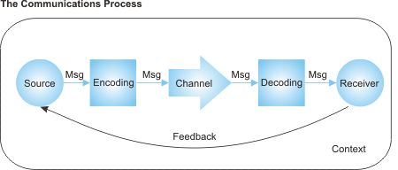
THE PROCESS OF COMMUNICATION:

Slide 14
Parts of the communication process
Sender: This is the person that is delivering a message to a recipient.
Message: This refers to the information that the sender is relaying to the receiver.
Channel of communication: This is the transmission or method of delivering the message.
Decoding: This is the interpretation of the message. Decoding is performed by the receiver.
Receiver: The receiver is the person who is getting or receiving the message.
Feedback: In some instances, the receiver might have feedback or a response for the sender. This starts an interaction.

Slide 15
How does the communication process work?
1. The sender develops an idea to be sent.
2. The sender encodes the message.
3. The sender selects the channel of communication that will be used.
4. The message travels over the channel of communication.
5. The message is received by the receiver.
6. The receiver decodes the message.
7. The receiver provides feedback, if applicable.

